Slide 1
Quantifying and Evaluating Trust in Automated Systems
Jayson Boubin
SOCHE Intern
Department of Systems Engineering and Management
Maj Christina Rusnock
Assistant Professor
Department of Systems Engineering and Management
October 9th 2015

Slide 2
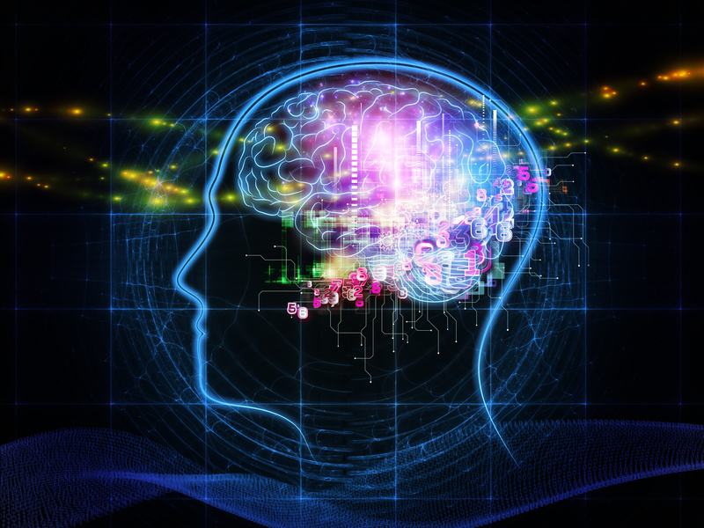
Automation as a Strategy
What is Automation?
Benefits of automation
  Increase performance
  Increase efficiency
  Increase safety
  Reduce errors
Often used in safety critical systems
  Failure could result in loss of life
Notes:
Automation is used in nearly every industry to prevent or limit human error
Many of these systems are safety critical. Failure could result in loss of life
Ignoring, misusing, or underestimating automation has led to grave consequences

Slide 3
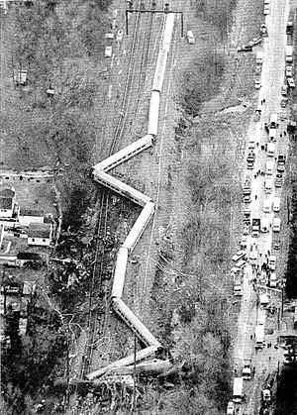
The Cost of Ignoring Automation
Used in:
  Nuclear power plants
  Mass transit
  Cyber security
  and other critical domains
Underuse can lead to grave consequences
  1987 Baltimore Train Derailment
  Numerous Controlled Flight accidents
Notes:
Automation is used in nuclear power plants, mass transit, cyber security, and other critical domains
Baltimore 1987 Train Derailment
Numerous Controlled Flight accidents

Slide 4
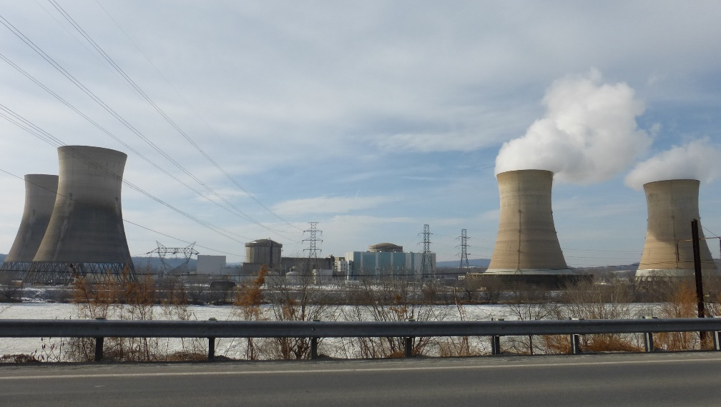
The Cost of Trusting Automation
Also involved in critical disasters
  Three Mile Island
  Security Flaws from Test Automation
Automation is not foolproof
  Both humans and machines
  can err
Notes:
Automation has also caused a series of critical disasters
Three Mile Island
Automation is not foolproof and can lead to equally as catastrophic events as human error
Trust in automation is learned by operators through its performance

Slide 5
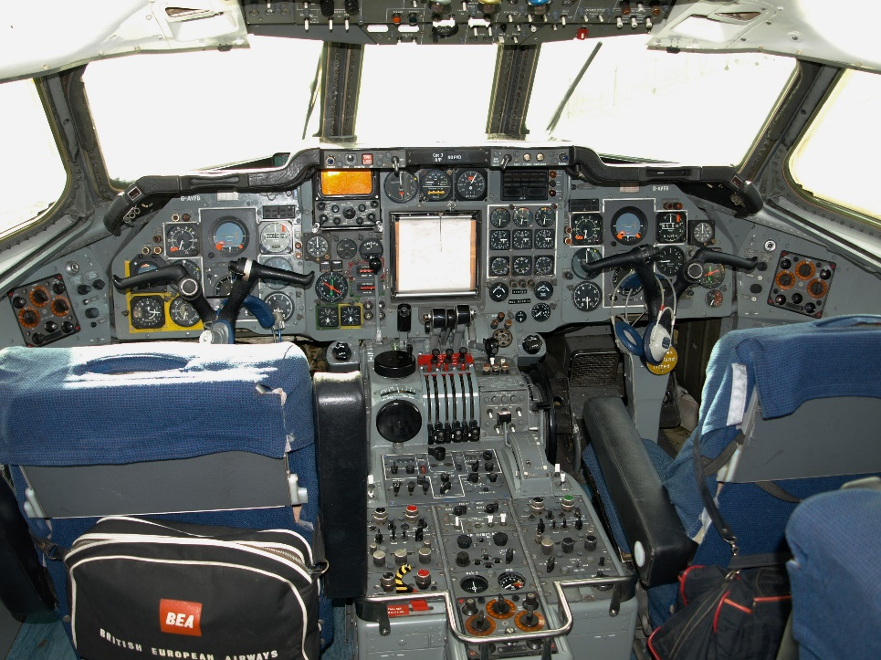
Human-Automation Teams
With increasingly complex tasks, humans must work in human-machine teams
Effective teams
  Understand each other’s abilities
  Have open communication
  Have trusting relationship
Trust in automation
  Built over time
  Based on performance consistent
  with expectations
  Can be lost
  Can be mis-calibrated
Notes:
As the complexity of automation increases, it becomes more important that the human and automation act as a team.
Humans must trust automation to perform properly, but must also trust themselves to discern incorrect automation actions.
To understand the big picture of “Trust” in automation, we must quantify trust in both ways.

Slide 6
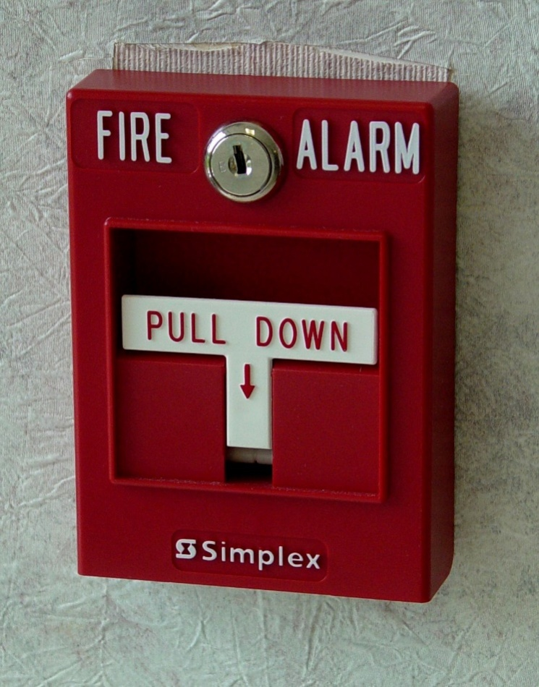
Compliance and Reliance
We can break “Trust” down into two components:
  Compliance and Reliance
Compliance: operator’s response when an alarm sounds
Reliance: refers to the operator’s response when the alarm is silent

Slide 7
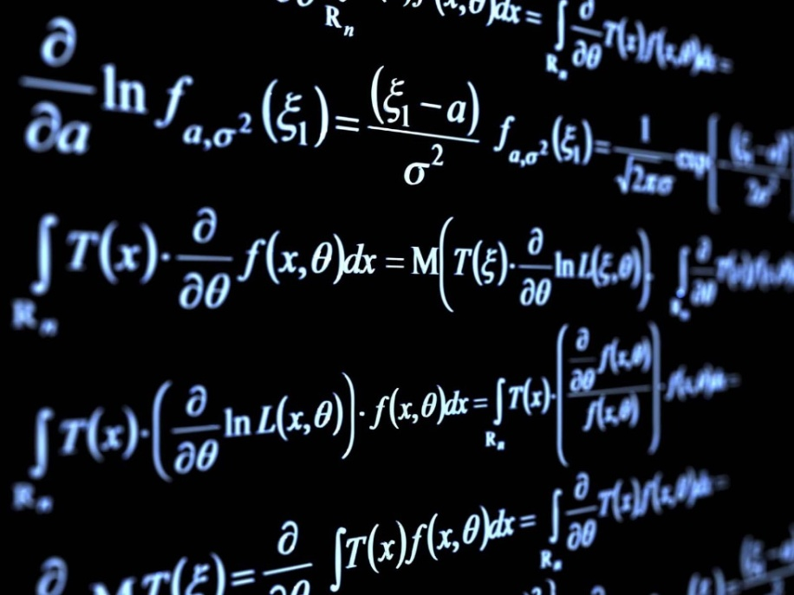
Quantifying Compliance and Reliance
For non-alarm automation, we can generalize the definitions
Compliance: operator’s acceptance
of automation actions
Reliance: operator’s expectation
that automation will take action if
required
Measurement
  Compliance - % concurrence with automation action
  Reliance - % of time automation is allowed to take the first action

Slide 8
Purpose
The purpose of this research is to:
  Define and quantify compliance and reliance in the context of a specific system
  Find factors in a system which significantly effect compliance and reliance
  Use these quantified values to create functions which will replicate compliance and reliance
  Use the elicited functions in a validated model of the specific system

Slide 9
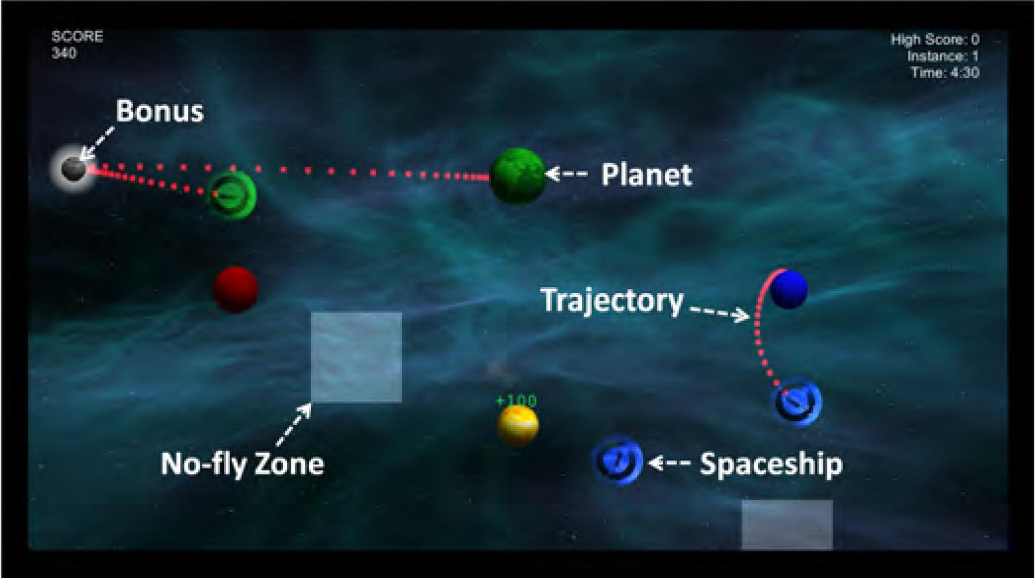
Experimental Environment
Space Navigator:
  Developed at AFIT
  Used to test the effectiveness of Human-Automation Teams
Components:
  Ships
  Planets
  No-fly Zones
  Bonuses

Slide 10
Automation Types
Space Navigator allows automation of ships
Automation Types:
  Similar
  Dissimilar
  Line
Automation is goal oriented
  Automation ignores ships, no fly zones and bonuses
Line Automation
Similar Automation

Slide 11
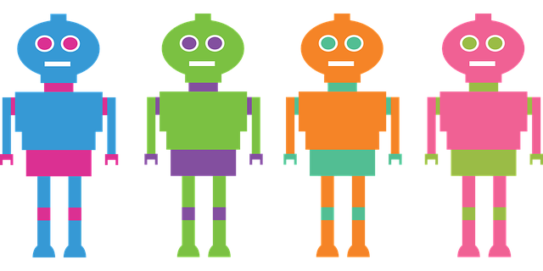
Space Navigator Benefits
Multiple automation types allow for more comprehensive view of trust
Automation types have distinct differences which impact performance
Automation is never 100% reliable

Slide 12
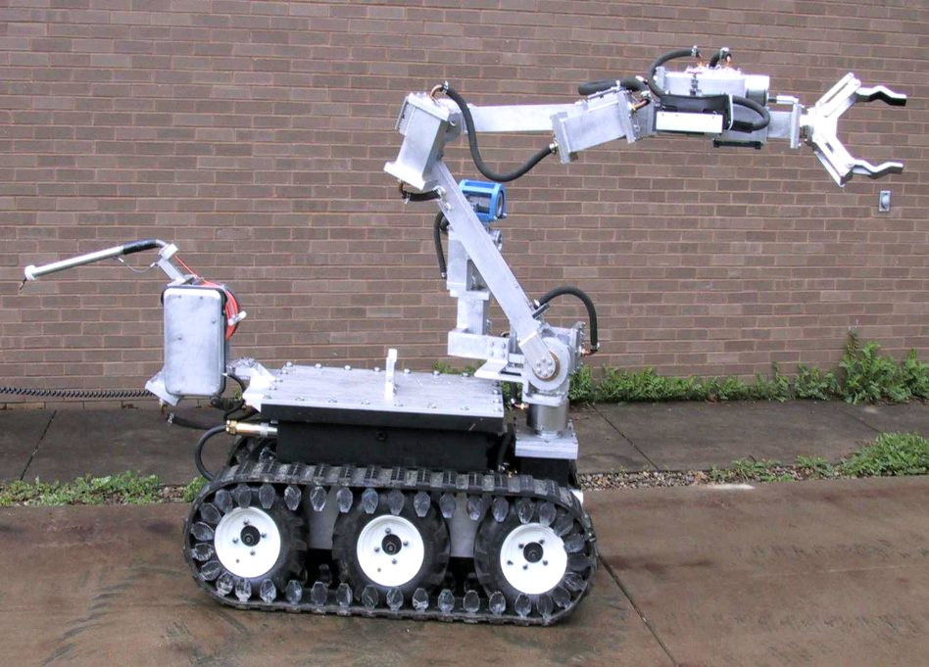
Trust in Space Navigator
Specifying compliance and reliance in this context:
  Compliance: Rate at which operator accepts (does not redraw) routes drawn by the automation
  Reliance: Rate at which operator allows the automation to initially draw ship routes

Slide 13

Factors Effecting Trust
Three major factors:
  Task load: the cognitive strain a task imparts on the user
  Time: The amount of time a player has spent with the automation
  Strategy: The type of automation being used

Slide 14
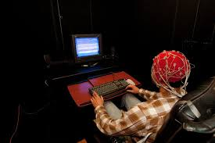
Human Data
Data gathered by Capt. Jason Bindewald through a human-subjects experiment
Collected a number of key events during Space Navigator gameplay
  Analyzed to interpret human trust
Each automation strategy can be assigned its own compliance and reliance rates through analysis

Slide 15
Data Analysis Results
There were significant differences in compliance and reliance between automation types in all instances
We were also able to find significant differences in compliance and reliance based on taskload in most cases
Amount of time remaining did not appear to significantly effect compliance and reliance.
Regression: Automation Draws as a factor of Taskload
Agent | Similar | Dissimilar | Line
P-Value | 0.003044 | 8.16E-06 | 0.289097
Regression: Redraws as a factor of Ships On Screen
Agent | Similar | Dissimilar | Line | Manual
P-Value | 0.00104 | 0.008326 | 0.007145 | 0.019148

Slide 16
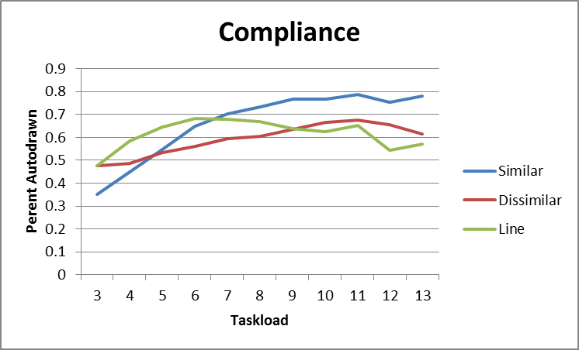
Compliance
Compliance rates based on taskload were also identified
Rates for Similar and Dissimilar automations were statistically different based on taskload
Using regression analysis, we were able to find that both similar and dissimilar automation exhibit significant trends. Line automation does not exhibit a significant trend over task load

Slide 17
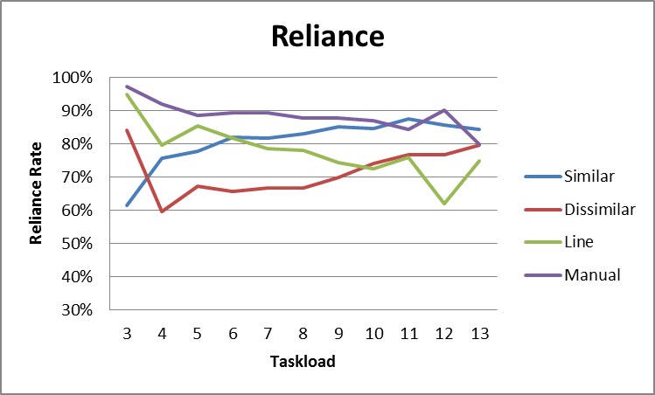
Reliance
We were able to find reliance rate based on taskload
Reliance rates for each automation type were statisitcally different from each other
We calculated significant trends for each automation type, which we translated to mathematical functions

Slide 18
Data Analysis
Created compliance and reliance based on:
  Taskload
  Automation type
These functions were implemented into discrete event simulations that model space navigator gameplay
Compliance Functions
Similar | R = -0.0136T + 0.2224
Dissimilar | R = -0.0176T + 0.374
Line | R = 0.018T + 0.1464
Manual | R = 0.0065T + 0.0961
Reliance Functions
Similar | R = 0.0364T + 0.5623
Dissimilar | R = 0.0239T + 0.5150
Line | R = -0.0046T + 0.6742

Slide 19
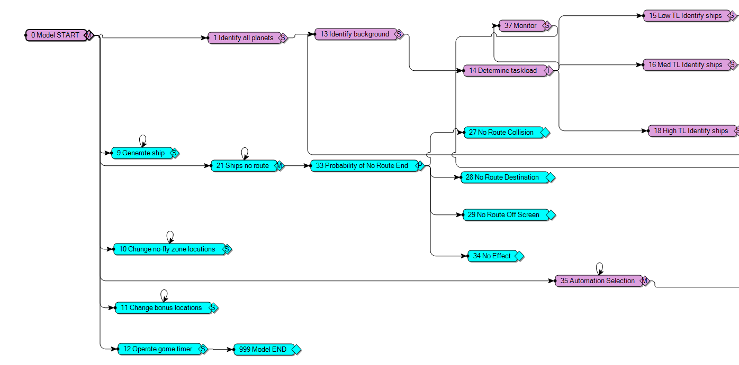
Modelling Compliance and Reliance
We were able to reduce Space Navigator into DES
  Human Cognition
  Game Events
The model uses our compliance and reliance functions to appropriately apply human trust to scenarios by automation type and taskload

Slide 20
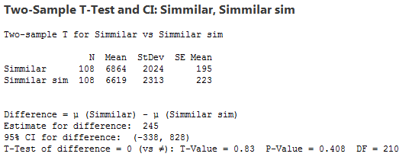
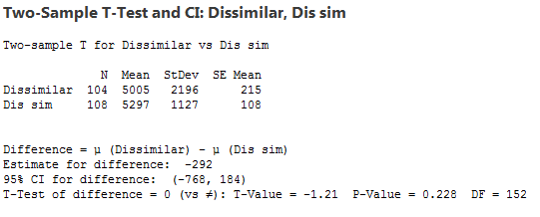
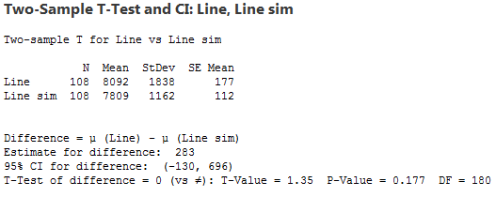
Model Results
We created four models:
  Baseline: no automation
  One for each automation type
Each model was validated against score data from human trials
We found no significant differences between the created models and the scored data (thus, validating the models)

Slide 21
Conclusion
We created functions to replicate compliance and reliance in a specified domain
We found significant differences in performance based on automation type and strategy
We successfully validated a simulation which used our elicited functions
This methodology can be replicated to create validated models for other systems, providing a process to test automation using discrete event simulation

Slide 22
Discussion
The ability to identify human trust in automated systems and design functions and models to replicate such trust and its results allows engineers to:
  Test automation using Discrete Event Simulation, saving the money and time of testing a physical system
  Calibrate existing automation to better interact with human operators
  Design smarter automated systems which properly account for human trust
Systems created or calibrated using this methodology should significantly prevent accidents due to misuse and disuse, saving money and possibly human lives.

